Slide 1
The Exam System – User Guide Global Technology Legal Compliance
June 01, 2012
Confidential

Slide 2
Agenda
Getting started:
Registering
Admin Page
Exam Creation
User Management
User Page
Exam taking

Slide 3
Getting Started
The Basics
http://<IP Address of Server>/exam_system/

Slide 4
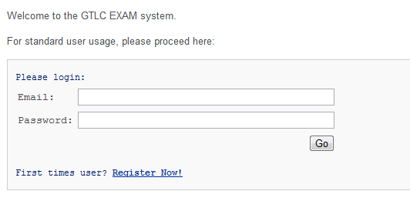
Registering
Click on the hyperlink to bring you to the registration page
After supplying the required information, your account will be created!
Note: Any valid email address will work, so you may use a non SAP address

Slide 5
Admin Rights/Page
There are a few
http://<IP Address of Server>/exam_system/admin/

Slide 6
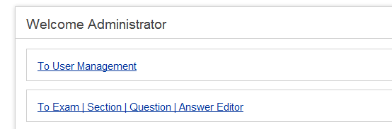
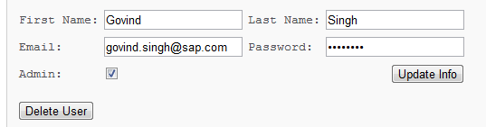

Admin Power
Only existing administrators can give new users admin rights as well;
This is done through User Management:
Click on the link “To User Management”
Select a user, check ‘Admin’ and click Update Info
Note: This is also the panel which is used to see previous user attempts of exams.

Slide 7
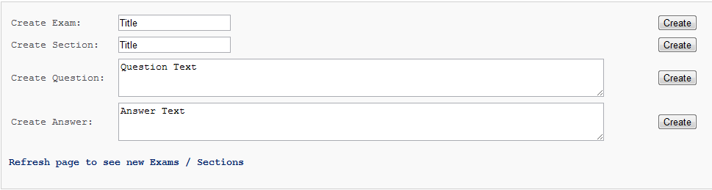
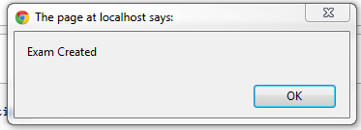
Exam Creation Page
You are able to create Exams, Sections, Questions and Answers here; as well as associate them to one another as you see fit.
Each text windows has a corresponding ‘Create’ button
Input the title/text of what you wish the exam/section/question/answer to be called/contain and click create.
Note: An alert will go off upon successful creation.
If you click create and an alert does not go off, contact the system administrator

Slide 8
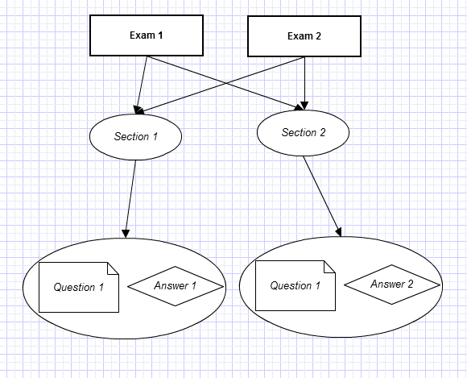
Exam Objects
It is necessary to understand how the systems objects (exams, sections, etc..) are related to one another in order to create proper exams.
Every exam can be linked with 0-many sections
Each section can be linked with multiple questions
Each question associated to any given section will be associated with an answer
This means that the same question existing in 2 different section can have differing answers
Example:
Question: Is this absence of color black or white?
The answer would depend on the section; if physics, black, if art, white

Slide 9
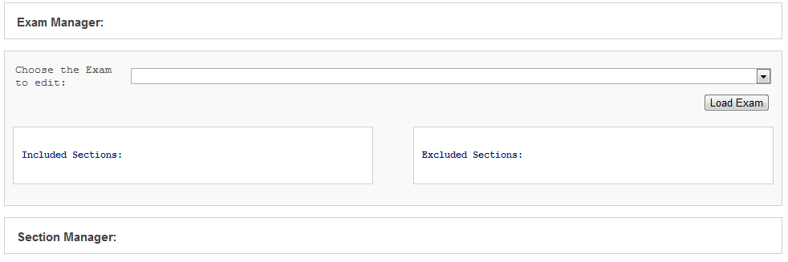
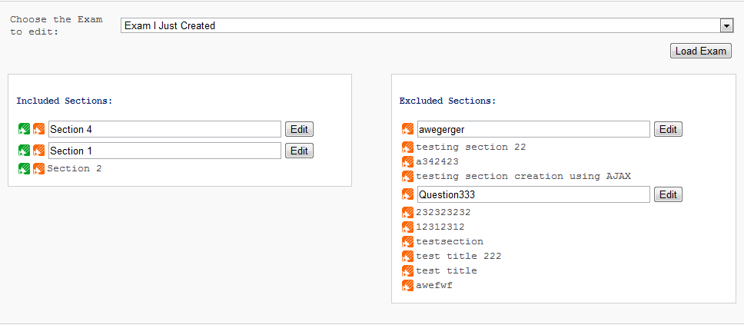
The Managers
Once your exams, sections, etc.. Have been created, you can associate them together using the provided managers.
The managers give you a way to associated the created pools of entities to one another (as shown in the previous slide)
Once an entity is chosen, the associated objects will be listed.
The green edit button will open a lightbox div containing the manager for that particular entity
The orange edit buttons will load edit panels for quick text edits.

Slide 10
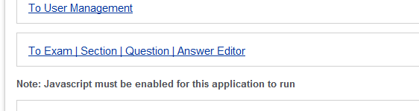
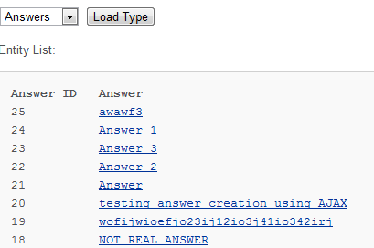
Big Edits
If you require to do an a larger edit to a particular question/answer, you can the actual editor panel to so.
Select the type of entity you wish to edit
Select the actual entity
Edit away
Note: this offers the same functionality as using the orange edit button; this simply give you a larger text area to type in.

Slide 11
User Page

Slide 12
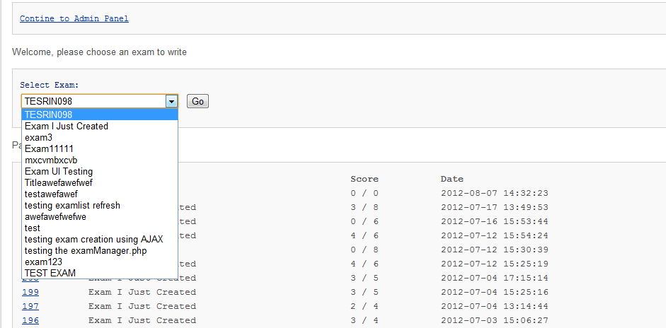
The User Panel
The user panel is the panel which greets all users upon login. The user panel contains all things which non admins will ever require.
Exam selector for taking exams
Record of previously taken exams with scores and dates taken
Links to past exams to see correct answers and what they answered with

Slide 13
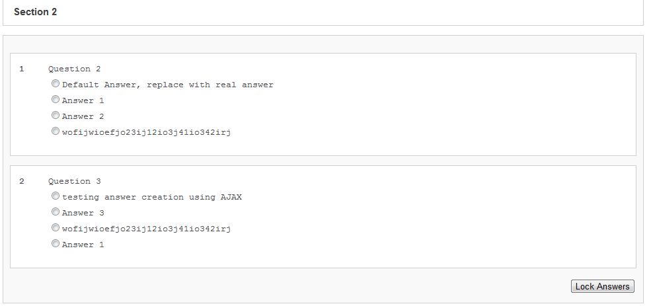
Exam Taking
After Selecting an Exam and pressing Go, the user will be greeted with a list of sections containing the questions and possible answers
Each question will contain a list of possible answers
Only one answer is selectable (selection is done via radio toggle)
Upon completion of a section, user must hit the “Lock Answers” button
After clicking “Lock Answers”, the section will become greyed out and the radios disabled.

Slide 14
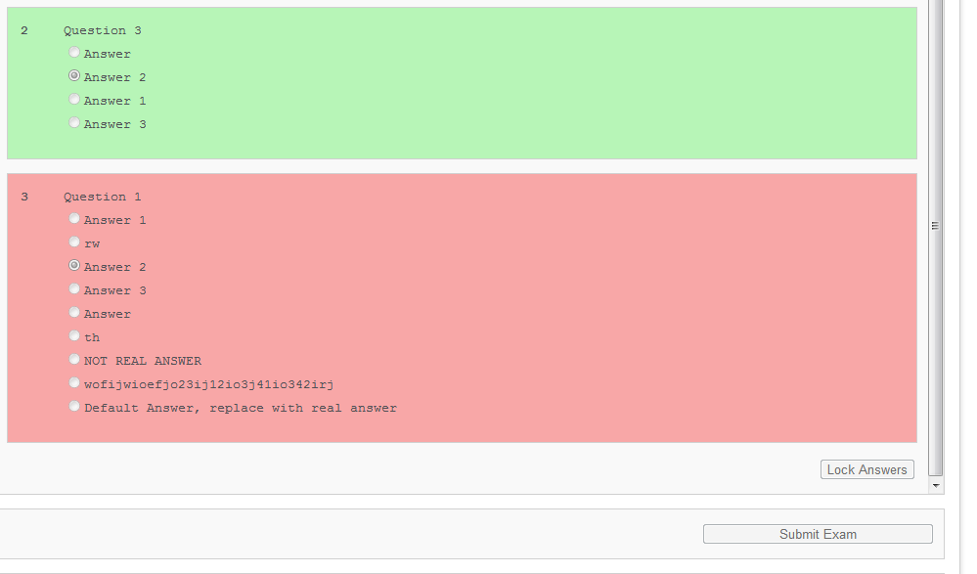

Exam Taking Continued
Once all sections are completed and locked, the user will have to click the “Submit Exam” button located in the bottom right corner of the page.
Once clicked, the then greyed out questions will change colors.
Green indicating a correct answer
Red indicating incorrect
The user can then return to the user panel to see their overall score

Slide 15
Thank You!
For more complete examples of what a context file should look like, as well as the actual XML Scema, please refer to this site:
https://tdwiki.pgdev.sap.corp/display/GTLC/Context+File+Requirement

